Slide 1

Predicting Bankruptcy with Machine Learning
UW FinTech – Nov 2022
Team # 2
Amrita Prithiani
Yu Takahashi
Jeremy Vargas

Slide 2

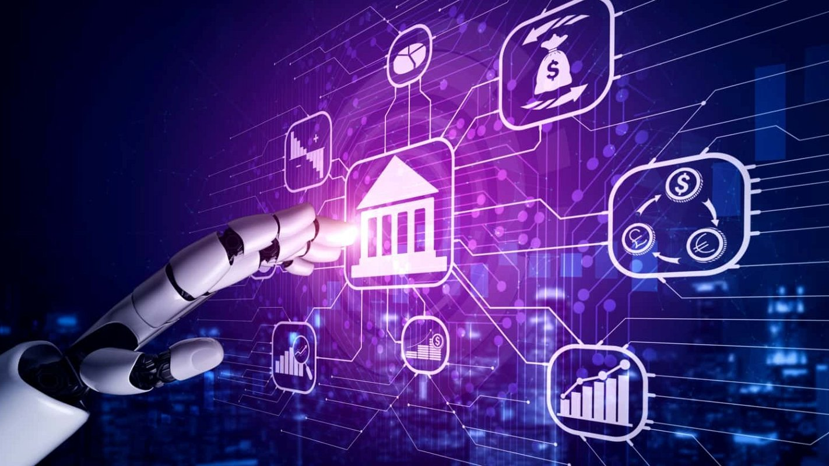
Predicting Bankruptcy with Machine Learning
UW FinTech – Nov 2022
Amrita Prithiani
Yu Takahashi
Jeremy Vargas

